Slide 1
Partner policy of UC Leuven-Limburg

Slide 2
Why networking?
Maintaining networks demands energy, so why?
Networks provide us with:
Information
Inspiration
Research possibilities
Common projects in education and training
A larger team
…

Slide 3
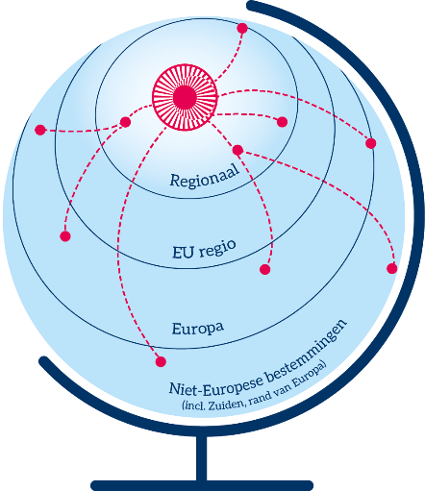
How?
From local, regional
to international and back
Using local networks
of international partners
International partners
with similar regional context

Slide 4
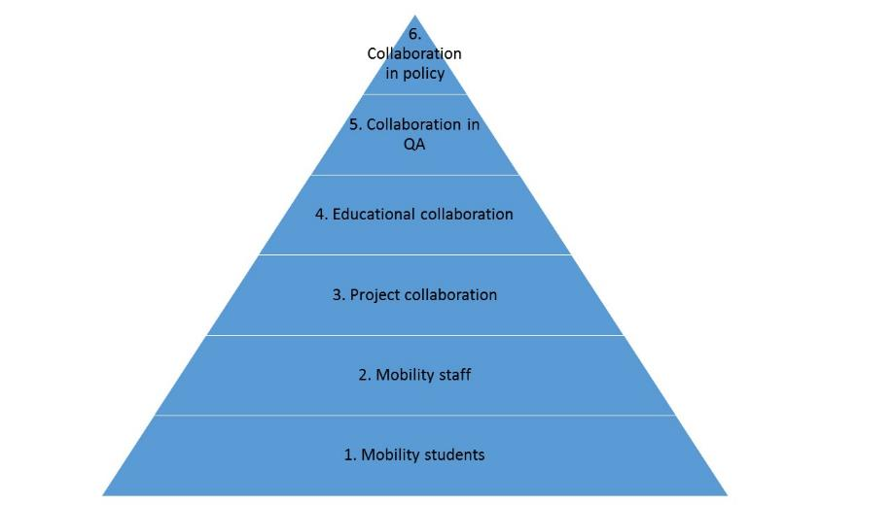
Pyramid
We structure our partnerships in the shape of a pyramid. The level indicates increasing intensity of cooperation from bottom to top, and a diminishing number of partners.

Slide 5
Pyramid
faculty
In theory each faculty and even each programme or research group could sketch their own pyramid.
degree
programme
faculty
degree
programme
degree
programme
degree
programme
degree
programme
degree
programme

