Slide 1
Masters Programmes @ London South Bank September 2019 & January 2020

Slide 2
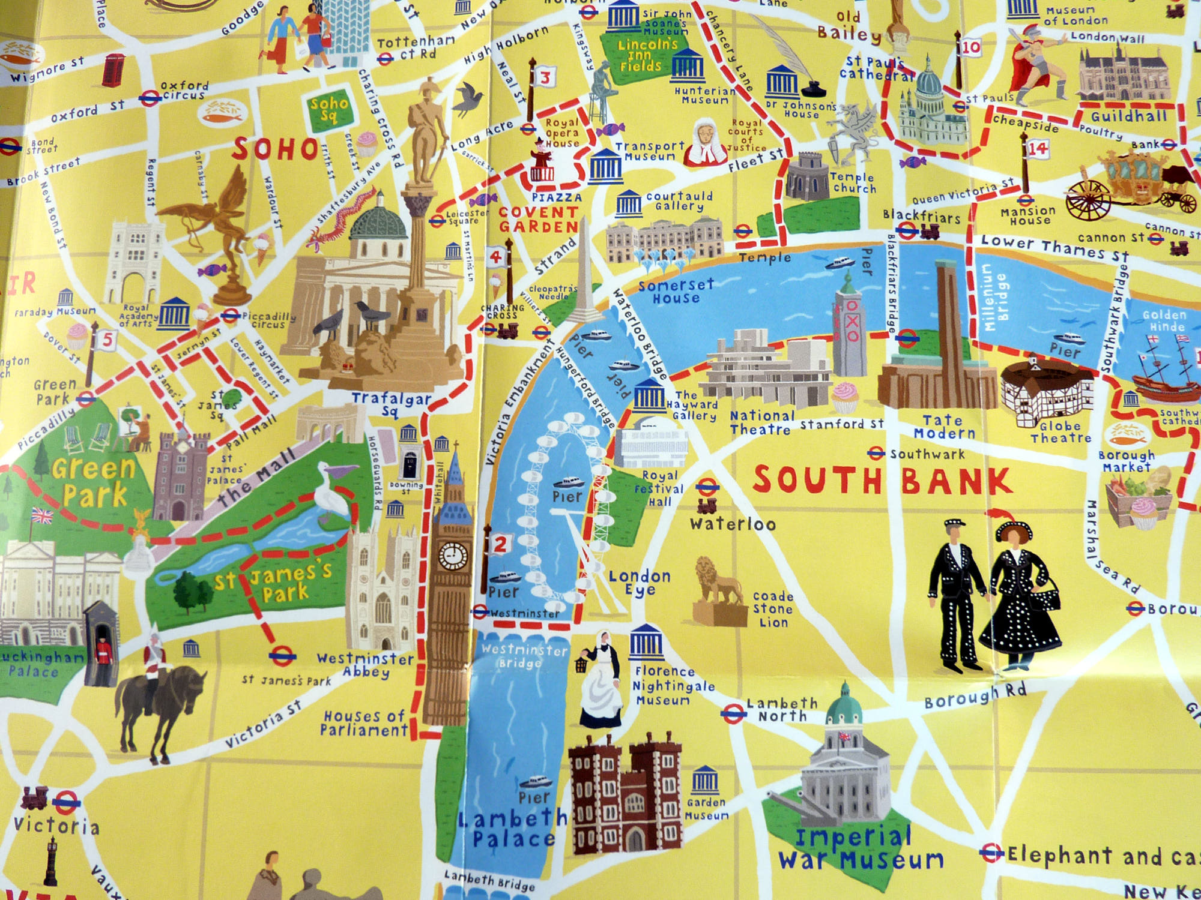

Slide 3
BANABA Programme: MSc Options at LSBU January 2020 onwards
BANABA Programme + LSBU January or June/ September
International Marketing
Marketing
Marketing Communications
International Business Management

Slide 4
BANABA Programme MSc Options at LSBU (1) International Marketing
MSc International Marketing
International Management Track
Digital Marketing & Communications Track

Slide 5
International Marketing (120 Credits (60 ECTS)
Year (120 credits)
Project Launch Residential | 0 credits
Cross Cultural Consumer Behaviour | 20 credits
International Pricing, Finance & Performance | 20 credits
Research in Action | 10 credits
Management Consultancy in a Global Environment | 10 credits
Two x 10 Credit Option Modules or Internship | 20 credits
Project Escalator Residential | 0 credits
Capstone Business Project | 40 credits

Slide 6
BANABA Programme MSc Options at LSBU (2) Marketing
MSc Marketing
Cultural Management Track
Digital Marketing & Communications Track

Slide 7
Marketing (120 Credits (60 ECTS)
Project Launch Residential | 0 credits
Corporate Strategy for Marketing | 20 credits
Marketing Management & Planning | 20 credits
Research in Action | 10 credits
Management Consultancy in a Global Environment | 10 credits
Two x 10 Credit Option Modules or Internship | 20 credits
Project Escalator Residential | 0 credits
Capstone Business Project | 40 credits

Slide 8
BANABA Programme MSc Options at LSBU (3) Marketing Communications
MSc Marketing
Communications
International Management Track
Digital Marketing & Communications Track

Slide 9
Marketing Communications 120 Credits (60 ECTS)
Project Launch Residential | 0 credits
Creative and Media Communication Strategies | 20 credits
Brand Management in an International Context | 20 credits
Research in Action | 10 credits
Management Consultancy in a Global Environment | 10 credits
Two x 10 Credit Option Modules or Internship | 20 credits
Project Escalator Residential | 0 credits
Capstone Business Project | 40 credits

Slide 10
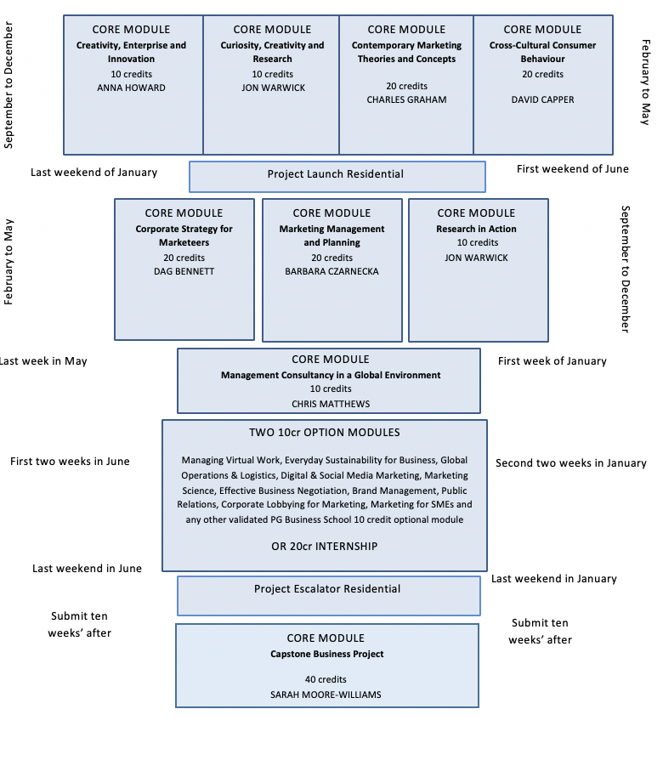
(June) September & January Start
BANABA Entry Point

Slide 11
Option Modules (Choose 2)…or 20 credit internship
Managing virtual work
Everyday sustainability for business
Global operations and logistics
Digital & social media marketing
Marketing Science
Effective business negotiation
Public relations
Corporate lobbying for marketing
Brand Management
Marketing for SMEs

Slide 12
BANABA Programme MSc Options at LSBU (4) International Business Management (new programme in development for Sept 2019)
Leuven | Advanced Batchelor Programme (60 Credits)
London | International Management (20 Credits) | International Marketing (20 Credits) | International Finance and Decision Making (20 Credits)
London | Dissertation (60 Credits)

Slide 13
Features of Our Courses
Residential weekends
The opportunity to obtain the Chartered Institute of Marketing (CIM) Diploma
The opportunity for consultancy practice
Opportunity to carry out a project that suits the students career needs
Business start-up advice & support during the programme for budding entrepreneurs
Opportunities to network with our post graduate research & enterprise community
Based in the heart of London

Slide 14
Sunday Times – Good University Guide – Student Satisfaction (Marketing)

Slide 15
Our partnerships and professional body accreditations

Slide 16
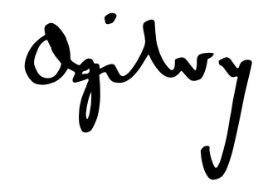
Where are they now …?

Slide 17
Application & Fees 2/3rds of published postgraduate fee Apply online www.lsbu.ac.uk/international no need to use UCAS Questions about admission email internat@lsbu.ac.uk Apply for accommodation once you have an offer – applications are on a first come first served basis.

Slide 18
Ayesha Owusu-Barnaby Associate Course Director: Marketing owusuba2@lsbu.ac.uk +44(0) 7815 7834

